Slide 1
Effects of Federal Tax Incentive on Electric Vehicle Sales for Tesla and Chevrolet
Will Price

Slide 2
Central Question
Does the federal tax credit have a statistically significant effect on electric vehicle sales?
Context:
The federal government provides a $7,500 tax credit for purchasers of electric vehicles.
Once a car manufacturer has sold 200,000 cars with the full credit, the credit begins to taper off –
50% less for two quarters
25% less for two quarters
Tesla and Chevrolet have exhausted the tax credit

Slide 3
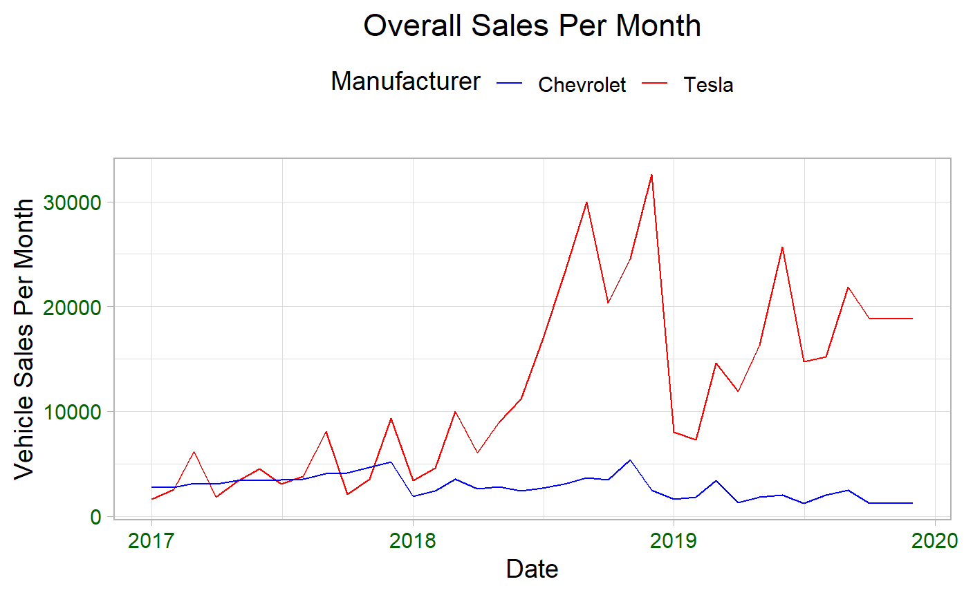
Data
Monthly vehicle sales data, 2017 – 2020, for Chevrolet and Tesla – InsideEVs.com
Tax credit availability for Chevrolet and Tesla, tabulated month to month for same period – IRS.gov

Slide 4
Wrangling
Monthly vehicle sales data for 2017 to 2020 manually scraped from insideEVs.com. Added up all vehicle models to get total manufacturer sales numbers. Sales figures from 2020 Q4 only available in quarterly format – extrapolated 2020 Q4 by dividing quarterly sales into months
Tax credit availability for Chevrolet and Tesla taken as quarterly data from IRS.gov. Expanded to monthly data.

Slide 5
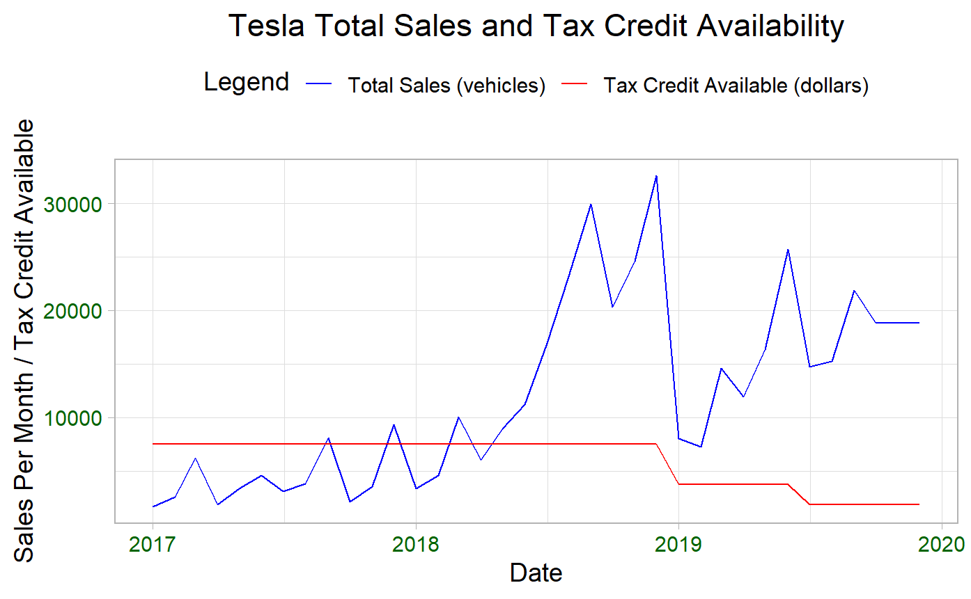
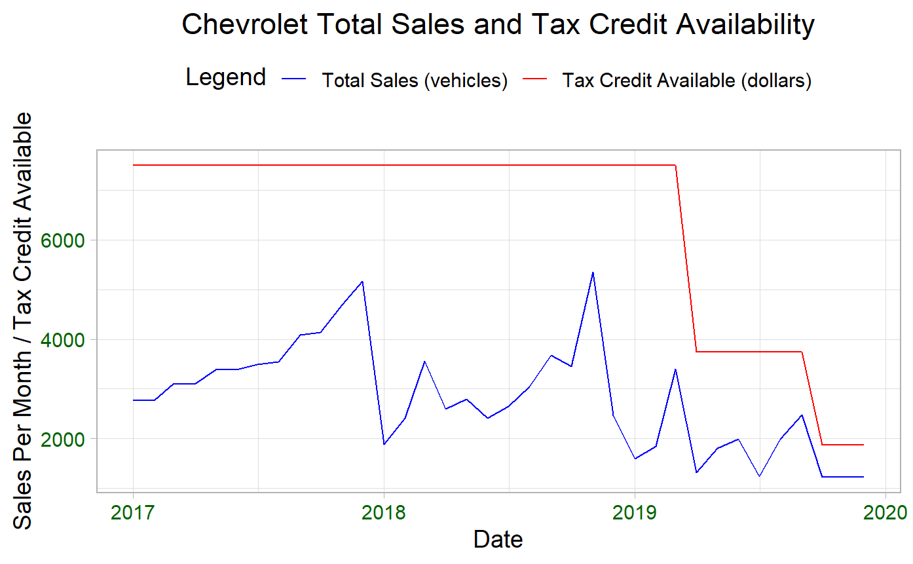
Analysis
Chevrolet:
Sales declining generally coming into 2019.
Appears to be dips in sales corresponding to dips in tax credit availability
Tesla: Huge jump through 2019 – causes?
New, more affordable model (Model 3)?
Buyers trying to get in before rebate is reduced?
Sales continue to climb post 2019, even as tax credit shrinks

Slide 6
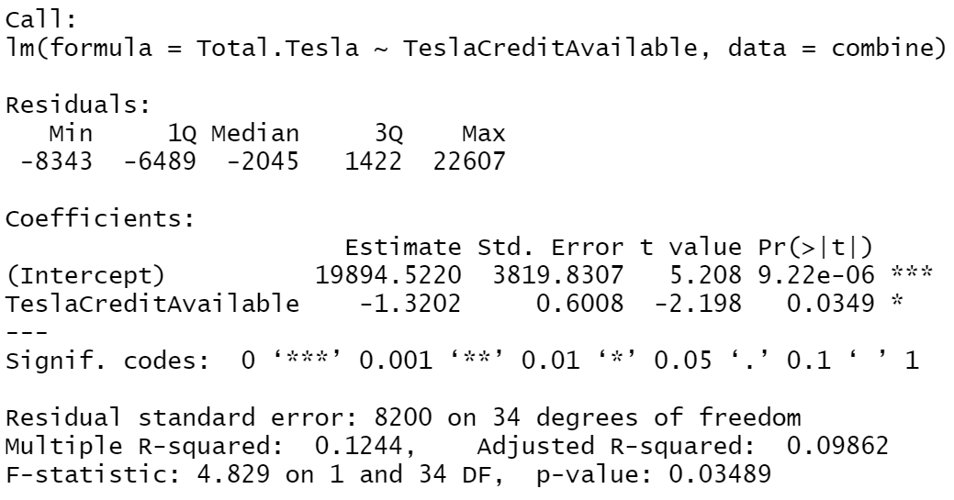
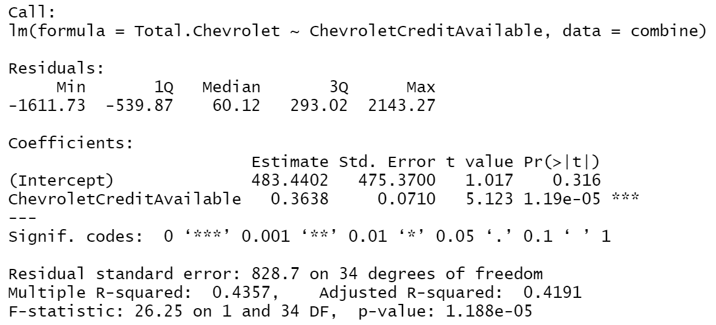
Results
Expect correlation to be significant;
expect positive coefficient (as available credit declines, sales should decline)
Tesla
Chevrolet
Just barely statistically significant
Still a dip corresponding to
Negative coefficient – due to increased sales as credit continues to dip?
Highly statistically significant
Positive coefficient – less tax credit available, less sales. Makes sense.

Slide 7
Summary
Why are figures for Tesla and Chevrolet so different?
My guess: Teslas are more expensive vehicles, so buyers’ decisions may be less influenced by discount that is smaller percentage of overall vehicle price
Consumers are self-selecting – those who buy Chevrolet electric vehicles are looking for most economical option; consumers who buy Tesla are already in luxury vehicle range so less concerned with a few thousand dollars on price tag
Other factors that could improve model –
overall economic trends – car sales generally
Sales of electric vehicle competitors that have not exhausted tax credit

